Slide 1
ASBMR-BHOF Virtual Hill Day Orientation
February 8, 2023

Slide 2
Welcome and Thank You!
2

Slide 3
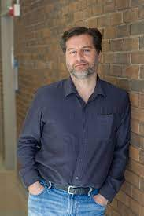
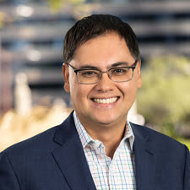
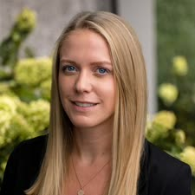
Panelists
Michael Hadjiargyrou, PhD
Chair, ASBMR Advocacy & Science Policy Committee
Claire Gill
BHOF Chief Executive Officer
Doug Fesler
ASBMR Executive Director
Hannah Miller
ASBMR Senior Operations Coordinator
3

Slide 4
Agenda
Welcome
Medicare Reimbursement for FLS
Meeting Tips
Online Schedules and Logistics
Leave Behind Materials and Participant Documents
Questions and Answers
4

Slide 5
Medicare Reimbursement for FLS
Medicare is the federal insurance plan for Americans 65 years or older – administered by the Centers for Medicare & Medicaid Services (CMS)
Physician Fee Schedule (PFS) is the complete listing of fees used by Medicare to pay doctors or other providers/suppliers – PFS is updated annually - FY24 PFS currently in development
5

Slide 6
Medicare Reimbursement for FLS
Medicare does not currently pay for a process that ensures individuals 65 years or older who experience a hip or vertebral fracture receive follow-up care for underlying osteoporosis
Fracture Liaison Service (FLS) programs are post-fracture care coordination services that assure that individuals who suffer a broken bone due to osteoporosis get the evidence-based care proven to help prevent additional fractures
ASBMR & BHOF are pursuing Medicare reimbursement for FLS through the CMS Physician Fee Schedule (PFS)
6

Slide 7
Medicare Reimbursement for FLS
Congressional legislation not required to change Physician Fee Schedule (PFS)
FY23 PFS for the first time acknowledged osteoporosis is a public health crisis that requires attention and modified a few quality measures but did not include our requested mechanism for FLS reimbursement
Our sense is that the proposal to pay for FLS wasn’t implemented due to lack of enough political pressure for CMS to make the change
“Political Pressure” = CMS hearing from members of Congress to make FLS a priority in the FY24 PFS proposed rule
7

Slide 8
Anatomy of a Congressional Office Meeting
Introductions (Be brief!)
“Ask”
Communicate why this issue is important to you
Summarize why change is needed
Reiterate the “Ask”
8

Slide 9
Hill Day “Ask”
“I am here to ask you to please contact CMS Administrator Ms. Chiquita Brooks-LaSure and urge her to use CMS’ authority to update Medicare payment policies, so that people who suffer osteoporotic fractures get the cost-effective care they need to prevent additional fractures. This will save lives and reduce Medicare costs.”
9

Slide 10
Why This is Important to You
Share short story/info about your personal experience with osteoporosis (e.g., family, clinician, investigator, patient) OR
Share why the need for better care after an osteoporotic fracture/broken bone is important and needed (See “Fact Sheet” in Documents Section)
10

Slide 11
Facts
Each year, more than 2 million people on Medicare suffer osteoporotic bone fractures, leading to costly hospitalizations and nursing home care. Total costs are expected to grow to over $90 billion by 2040. Experts agree that many of these costly fractures can be prevented.
In the Medicare population, osteoporotic fracture patients are 3x more likely to suffer another fracture within a year.
A recent analysis of the 2016 Medicare claims data revealed that 1.8 million beneficiaries suffered approximately 2.1 million osteoporotic fractures. 42,000 patients were institutionalized in nursing homes within three years.
There is an 80% care gap for people who break a bone due to osteoporosis and don’t get the required follow up care. For example, only 20% of hip fracture patients receive medication for their osteoporosis to prevent a second fracture, compared to 96% of heart attack patients receiving medications to prevent a second heart attack.
The total annual cost for osteoporotic fractures among Medicare beneficiaries was $57 billion in 2018 and expected to rise to $95 billion by 2040.
11

Slide 12
Why Change is Needed
Current patient care is fragmented, resulting in those that break a bone not receiving the follow-up care needed to prevent another bone break
Medicare does not currently reimburse for a process that ensures individuals 65 years or older who experience a hip or vertebral fracture receive follow-up care for underlying osteoporosis
The American Society for Bone and Mineral Research and Bone Health and Osteoporosis Foundation, along with 30 other leading organizations, have been urging CMS to adopt a process to address this crisis via a Fracture Liaison Service (FLS)
FLS programs are post-fracture care coordination services that assure that individuals who suffer a broken bone due to osteoporosis get the evidence-based care proven to help prevent additional fractures
After numerous successful meetings with CMS, HHS, and OMB in 2021 and 2022, the bone health community was very disappointed to see our proposal ignored in the FY23 Physician Fee Schedule proposed/final rule
12

Slide 13
Hill Day “Ask”
“Again, I am here to ask you to please contact CMS Administrator Ms. Chiquita Brooks-LaSure and urge her to use CMS’ authority to update Medicare payment policies, so that people who suffer osteoporotic fractures get the cost-effective care they need to prevent additional fractures. This will save lives and reduce Medicare costs.”
13

Slide 14
Meeting Tips & Reminders
Log-on promptly….but be patient if aide is late
Turn off your cell phone
Expect to have 15 – 20 minutes for each meeting
Introduce all participants
Name and institution/affiliation – not entire CV!
Get to the “ask”/ talking points quickly
Share a personal story
Explain why the issue matters to the state/district (use local data)
If you don’t know an answer to a question…
Say “I don’t know but I will get back to you with the answer”
Send note to ASBMR staff to follow-up in meeting platform!
Present “leave behind” materials
14
Notes:
Most of your meetings will be short – this is typical. A 15-minute meeting can be effective if you use your time wisely. There’s no need to beat around the bush – the people you will be meeting with expect you to ask them to do something.

Slide 15
Follow-Up From Your Meetings
Send thank you notes
Via meeting platform or email
Add your contact information
Include any follow-up information you promised
Links to online documents work best
Avoid sending large PDF’s/files
Remind staff/members about any outstanding requests or information they promised to get for you
Report any questions/concerns from the meetings to ASBMR or BHOF staff
15
Notes:
Follow-up is extremely important! A thank you note is a must but since all mail sent to Capitol Hill goes through an elaborate screening process before it is delivered and can be delayed by 4 to 6 weeks, email is the best method of communicating with the aides you met with.
Also, due to security concerns and the volume of email they receive, most congressional staffers have strict limits on the size of messages they can receive. When sending follow-up information, include hyperlinks to key documents in the text of the message instead of attachments whenever possible. If you must send a large PDF or document, break it up into smaller files and send it via several messages instead of a single one.
And don’t forget to remind the aides you met with if they promised to get information you requested about the member of Congress’ position on NIH funding or other issues you discussed
Any questions or concerns you may have after your meetings should be reported to Hannah, Doug or Claire

Slide 16
Other Troubleshooting
You get the “blank stare” or no response
The person you are meeting with is distracted during the virtual meeting
The person you are meeting with doesn’t appear to know anything about CMS
The aide makes a political/partisan comment or asks your opinion on political matter not related to our “ask”
16

Slide 17
Establishing Long Term Relationships
Identify connections with elected officials
College alumni, church, hometown, local business, volunteer group, etc.
Note the connection(s) so you can refer back to it/them later
Be a better constituent
Subscribe to your Senators/Representative’s electronic newsletter
Follow your elected officials on social media
Attend congressional town hall meetings and other local events
Stay in touch throughout the year
Send updates about relevant topics or research you discussed
Keep elected officials abreast of exciting developments at your institution (federal grants received; major awards given to personnel; new facilities, etc.)
Document visits in your department/ institution’s newsletter
Include photos!
Post on social media (follow your institution’s policies!)
17
Notes:
Establishing relationships with your members of Congress will not happen immediately. These are some things you can do after you get back from your visit to Capitol Hill to continue engaging with your elected officials.

Slide 18
Online Schedules and Logistics Overview
18

Slide 19
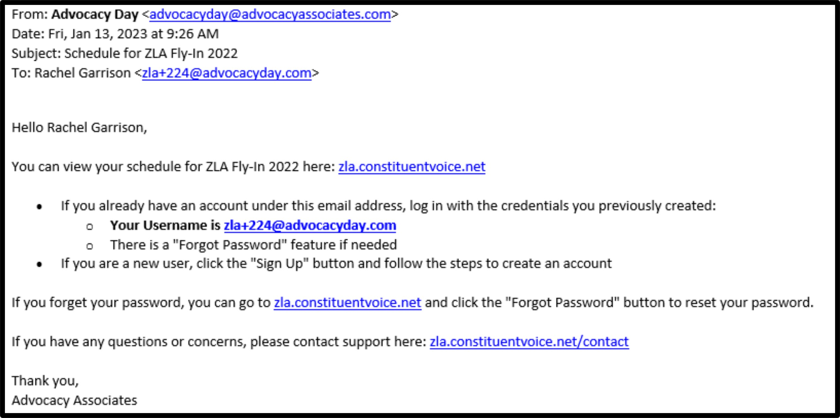
Receiving Your Schedule
You will receive an automated email from Advocacy Associates on a to-be-determined date by your organization
Check your SPAM/JUNK folder if you think you did not receive the email
Verify with your organization on the date schedules were/will be sent
Click on the URL to access your schedule. Follow instructions on how to login
Contact us for any technical support
19

Slide 20
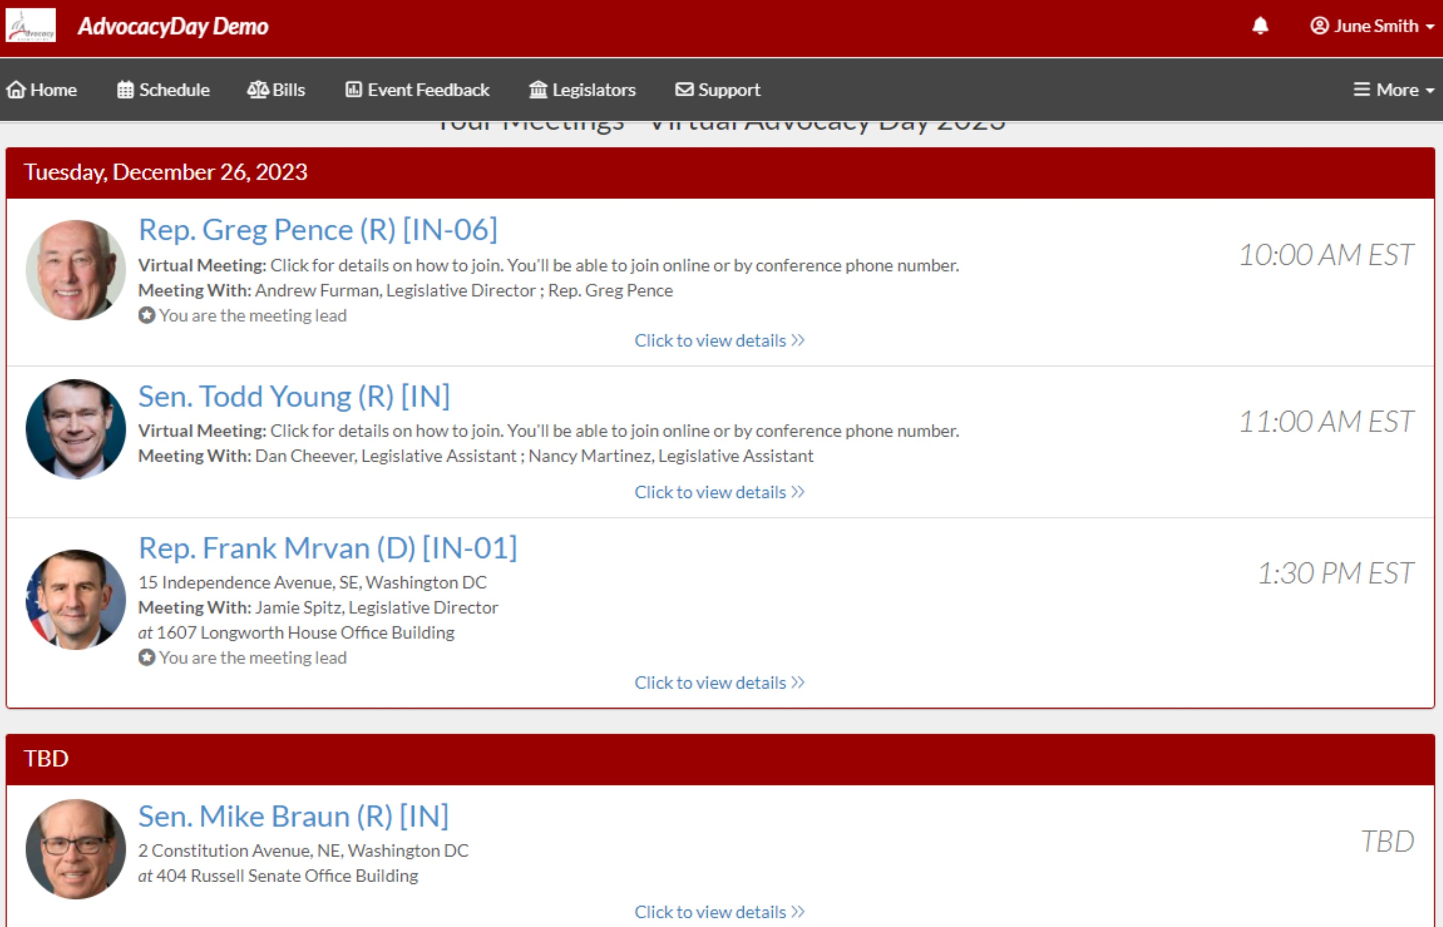
Main Schedule Page
Confirmed meetings display with a time
Pending meetings display on bottom
All times will be displayed in time zone you are located in
Click on each meeting to access the information
20

Slide 21
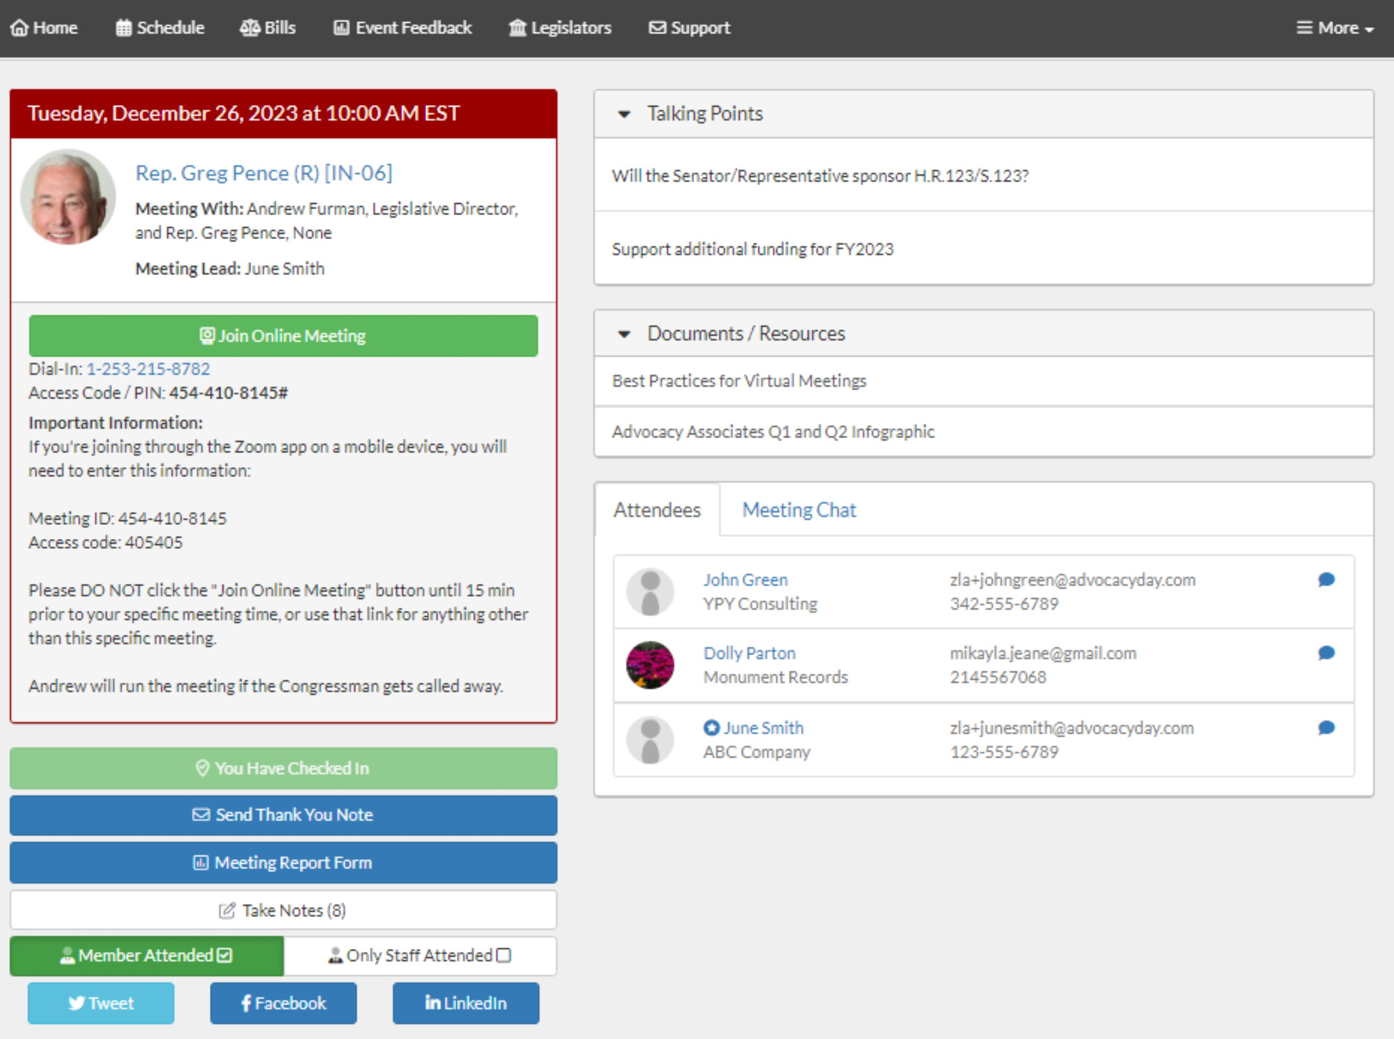
Date and Time
Meeting With
Meeting Lead (if assigned by your organization)
Click “Join Online Meeting” to open video component (not all meetings will have a video component)
Dial-in/additional information
21

Slide 22
Relevant Information and Reminders
Check your SPAM/JUNK folder to ensure you didn’t miss the email with the link to your schedule (domain is @advocacyassociates.com)
Please call/video into the meeting 10 minutes prior to the start time, in order to discuss with your group on who will open the conversation and who will be speaking
All times will be shown in the time zone you are located in when viewing your schedule
You will receive a reminder email 1 hour prior to each meeting from Advocacy Associates with a link to your schedule
If the office does not join the meeting within 10 minutes past the start time, contact Advocacy Associates
There will be a help number listed in the Support tab to call if you need to get ahold of Advocacy Associates
Meetings may last anywhere from 15-30 minutes, prepare your pitch and talking points accordingly. ASK how much time the office has
Any changes to your schedule the day of the event will be sent to you via email. Please be sure to check regularly throughout the day
Make sure you are in an area with a good Wi-Fi connection
Mute your microphone if you are not speaking
Know your audience - ensure you have an appropriate background
22

Slide 23
Hill Day “Ask”
“I am here to ask you to please contact CMS Administrator Ms. Chiquita Brooks-LaSure and urge her to use CMS’ authority to update Medicare payment policies, so that people who suffer osteoporotic fractures get the cost-effective care they need to prevent additional fractures. This will save lives and reduce Medicare costs.”
23

Slide 24
Leave Behind Materials
Preventing Avoidable and Costly Secondary Osteoporotic Fractures
Summary of the problem and solution
Sample Hill Letter to CMS
Points Congressional staff can use in their outreach to CMS
Medicare Cost Of Osteoporotic Fractures by State
Provide detailed state-level review of the incidence of osteoporotic fractures, their health care impact and associated Medicare costs
24

Slide 25
Participant Documents
About ASBMR & BHOF
Fact Sheet
Why Change is Needed
25

Slide 26
Social Media
#ASBMR-BHOFHillDay
26

Slide 27
Hill Day Questions
Hannah Miller
ASBMR Senior Operations Coordinator
hmiller@asbmr.org
+1 (202) 367-2343
27

Slide 28
Thank You!

Slide 29
Questions

